Slide 1
🚀 Integrating Apache Spark with MySQL Using PySpark
In the era of big data, Apache Spark has become a go-to engine for large-scale data processing due to its in-memory computing power and easy-to-use APIs. On the other hand, MySQL is a widely-used relational database system. Often, you may need to integrate Spark with MySQL to read or write data — especially for ETL jobs, analytics, or batch processing tasks.
In this article, I’ll walk you through how to connect Apache Spark with MySQL using PySpark.
For more info please follow :- Mohit Singh
Git hub for more detail :- Git Hub links

Slide 2
To follow along, you’ll need:
Apache Spark installed on your local machine.
PySpark installed (pip install pyspark).
MySQL Server running locally or remotely.
MySQL JDBC Connector (Java driver).
Basic knowledge of Spark and SQL.

Slide 3
Download the MySQL JDBC Driver
To enable Spark to communicate with MySQL, we need the MySQL JDBC Driver (mysql-connector-j). You can download it from the official MySQL site.
Place the .jar file in a known location on your system.

Slide 4
from pyspark.sql import SparkSession
# Initialize SparkSession
spark = SparkSession.builder \
.appName("Spark MySQL Integration") \
.config("spark.jars", "C:\\Users\\Praveen Sharma\\Downloads\\mysql-connector-j-9.2.0\\mysql-connector-j-9.2.0\\mysql-connector-j-9.2.0.jar") \
.getOrCreate()
# MySQL connection properties
mysql_url = "jdbc:mysql://localhost:3306/sakila"
mysql_properties = {
"user": "root",
"password": "Mysql!@#123",
"driver": "com.mysql.cj.jdbc.Driver"
}
# Table to query
table_name = "actor_info "
# Fetch data from MySQL
df = spark.read.jdbc(url=mysql_url, table=table_name, properties=mysql_properties)
# Show the data
df.show()

Slide 5
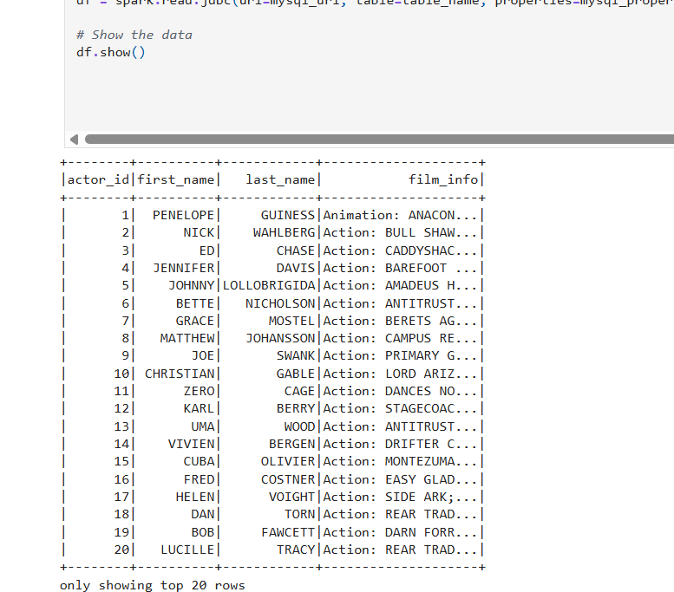

Slide 6
from pyspark.sql import SparkSession
# Initialize SparkSession
spark = SparkSession.builder \
.appName("Spark MySQL Integration") \
.config("spark.jars", "C:\\Users\\Praveen Sharma\\Downloads\\mysql-connector-j-9.2.0\\mysql-connector-j-9.2.0\\mysql-connector-j-9.2.0.jar") \
.getOrCreate()
# MySQL connection properties
mysql_url = "jdbc:mysql://localhost:3306/sakila"
mysql_properties = {
"user": "root",
"password": "Mysql!@#123",
"driver": "com.mysql.cj.jdbc.Driver"
}
# SQL query for data extraction
sql_query = """
SELECT
CONCAT(ac.first_name, ' ', ac.last_name) AS `Actor Name`,
f.title,
f.description,
f.release_year,
f.rental_duration,
f.rental_rate,
f.length,
f.replacement_cost,
f.rating,
f.special_features,
l.name AS `language name`
FROM actor_info ac
LEFT JOIN film_actor AS ft ON ft.actor_id = ac.actor_id
LEFT JOIN film AS f ON f.film_id = ft.film_id
LEFT JOIN language AS l ON l.language_id = f.language_id
WHERE 1=1
"""
# Fetch data from MySQL using the SQL query
df = spark.read.jdbc(url=mysql_url, table=f"({sql_query}) AS subquery", properties=mysql_properties)
# Show the data
df.show()

Slide 7
